Slide 1

Prezentare Big Data Analysis – 2022 – Proiect BDA-P14 Spark – Analyzing Google Dataset
Silvan Niculita – MISS2

Slide 2
Project Description & Goals
1
Medicare

Slide 3
Target of the project
The topic for this project was to research a large dataset by using pyspark and to extract data from it using python queries. My goal on the other hand was to isolate a number of relevant research figures that can be used in a thesis project.
The dataset I used for it is based on Google Cloud:
https://console.cloud.google.com/marketplace/product/hhs/medicare

Slide 4

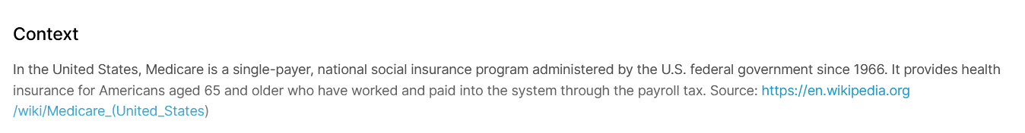
Dataset Used - Medicare
The dataset is used is called Medicare – and though it does state it is used by people up to 65 – the project has been extended to service more people.

Slide 5
Understanding the Dataset
To be more specific, the data itself is not relevant, but based on the charts generated we can make deductions on how often certain patterns repeat themselves and focus on using that information in developing a medical report generation program.
As such the Medicare dataset from the google cloud contains information (albeit rather incomplete) of actions that take place in the medical system in the USA and has a lot of irrelevant (to us) financial data.

Slide 6
Brief ending
The graphs focus on a number of demographics - such as diseases / types of illnesses / frequency rate / age of the people in the study as well as other issues - and mixes these information all so that we can find out what are the most common elements that we may take an interest into.
More will be exemplified with each slide.

Slide 7
Charts & Code
Results from queries

Slide 8
Project - Folder Structure
Queries
The queries are those that we run on the machine which extract and sort the data we need based on the criteria inputed. Queries have mainX.py files in them.
Graphs
The graphs are generated from the data, listing only what we consider viable information. While some folders hold a lot more graphs then we have here in the presentation – it will suffice to show only a single example of a kind. I generally have a graph.py

Slide 9
Scripts 1:
Main.py - d_by_age: - Primul script se bazeaza pe analiza la datele din nursing facilities din america in anul 2014 - ce m-a interesat erau numarul de cazuri procentuale de boli existente. Daca este sa dezvolt o aplicatie web care sa genereze rapoarte de sanatate, trebuie sa am un baseline pentru ce boli este nevoie si care sunt cele mai comune intalnite.
Graficele generate din un singur script - aratand un baseline in functie de varsta - ceea ce ar ajuta destul de mult cand se creeaza categorii pentru aceste rapoarte (un om de 80 de ani nu poate avea same report cu unul de 40 si anamneza trebuie sa fie mai documentata)

Slide 10
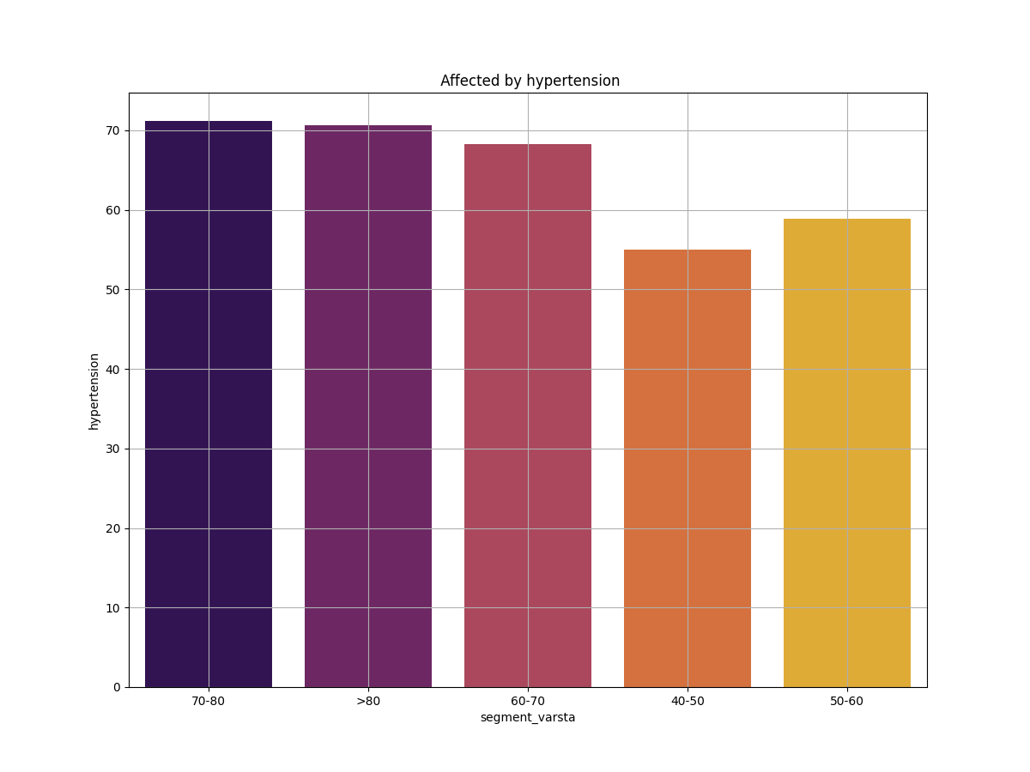
Graph 1:
Sort by age – Comparing all existing graphs the most interesting factor is that hypertension is one of the most commonly met issues in most people

Slide 11
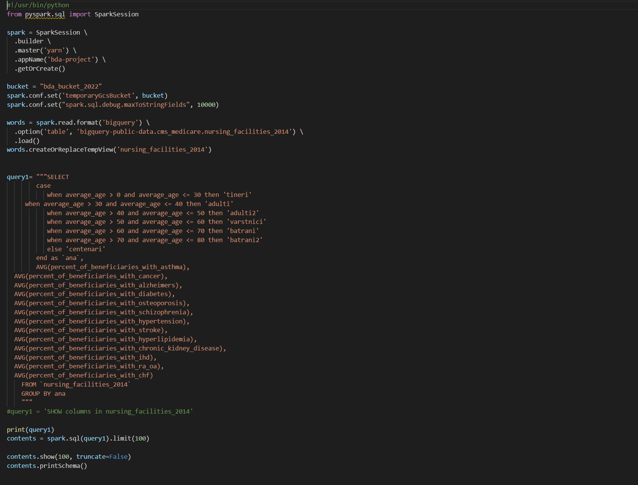
Script 1 – Code Snippet:

Slide 12
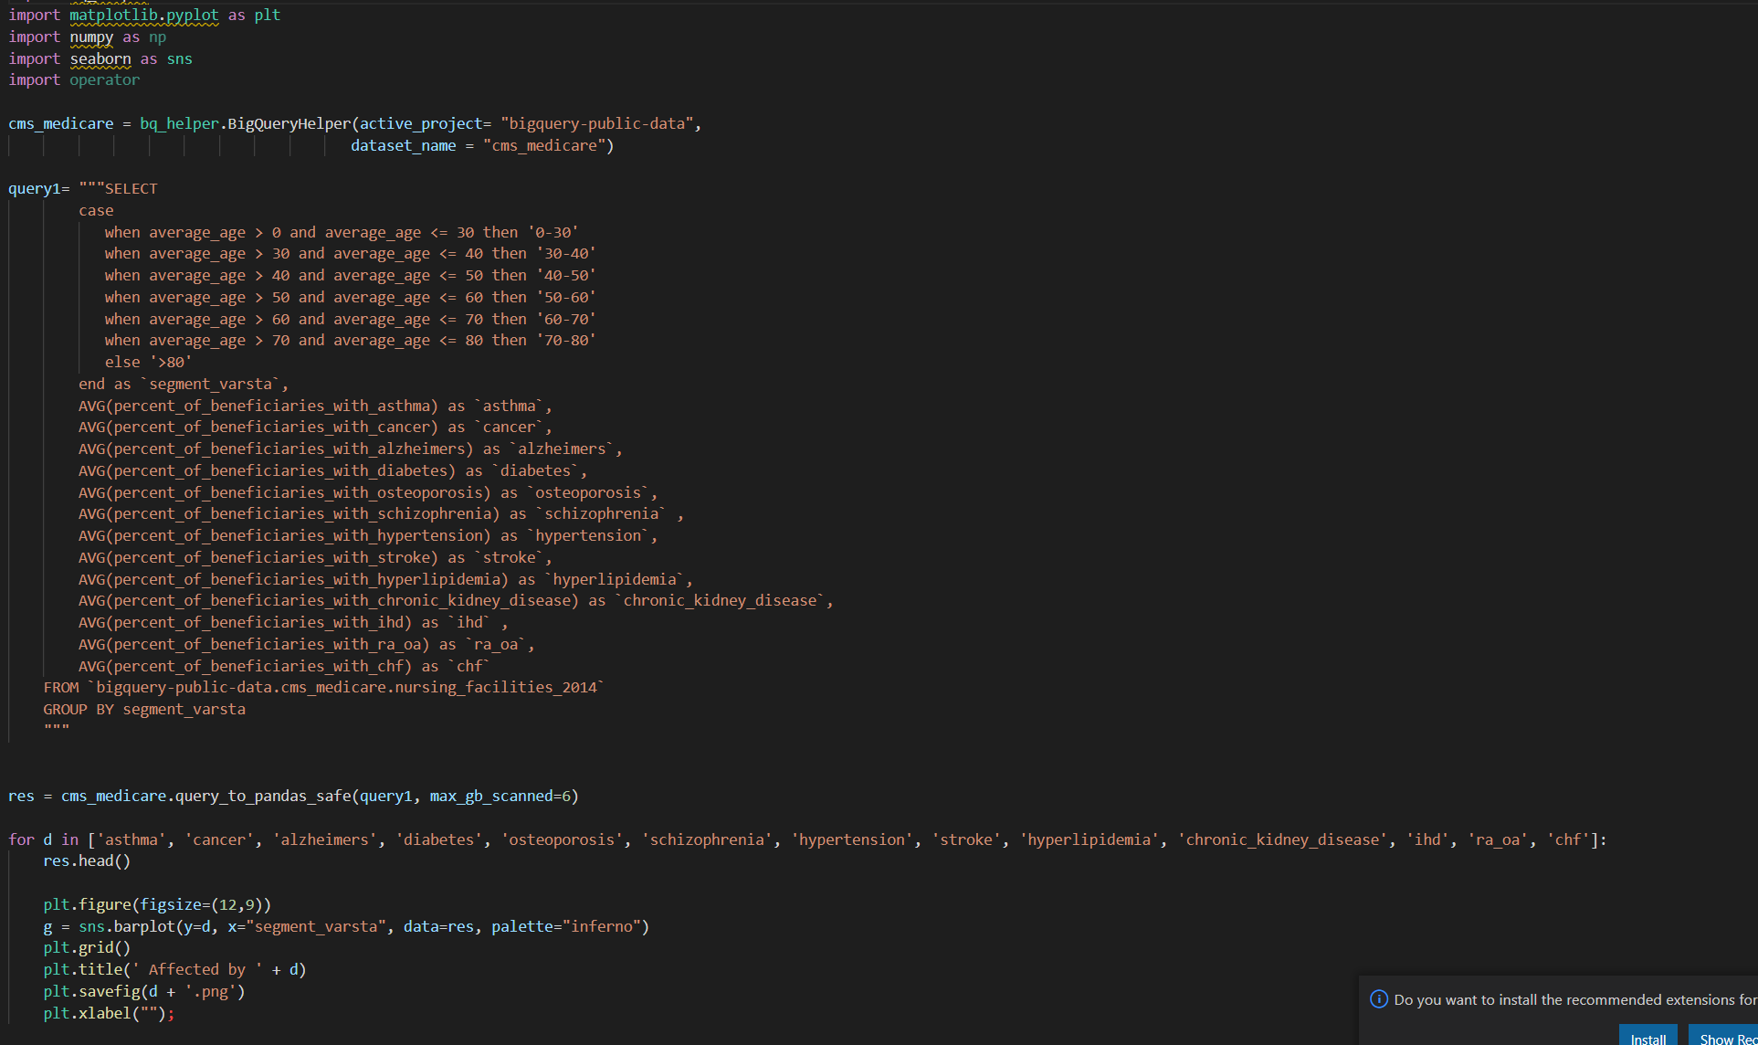
Graph 1 – Code Snippet:

Slide 13
Scripts 2:
Main2.py - gender_group: - Another interesting search was to analyze the data that can be found in the fields of health agencies - these being doctors' offices/dispensary, etc. - and to sort according to the female and male gender of the people who are treated - depending on the disease they have. This example is to be able to check if there are major differences if any search filter is changed and how often there would be certain specialized reports from case to case - I could choose other criteria besides sex, but it seemed the easiest without create a bias.

Slide 14
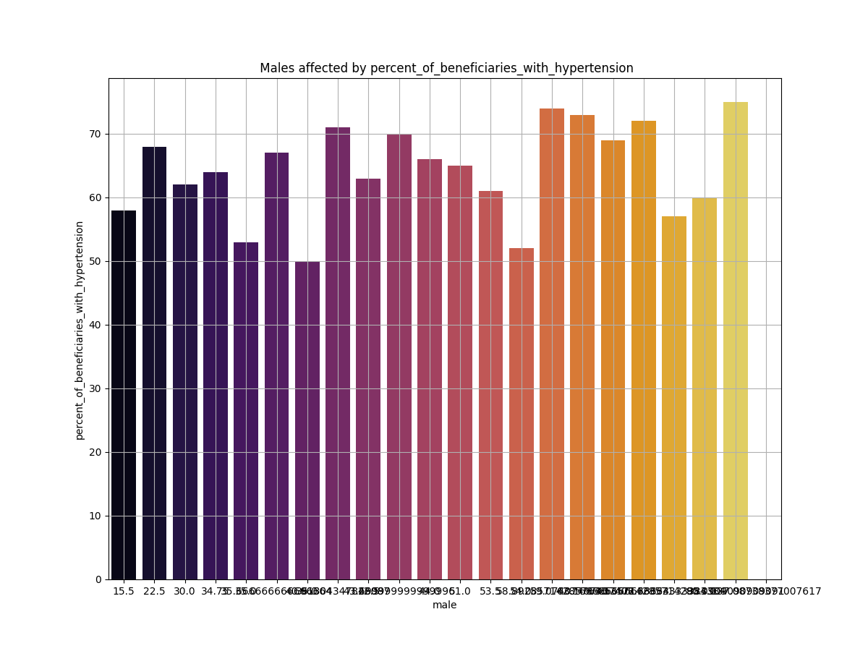
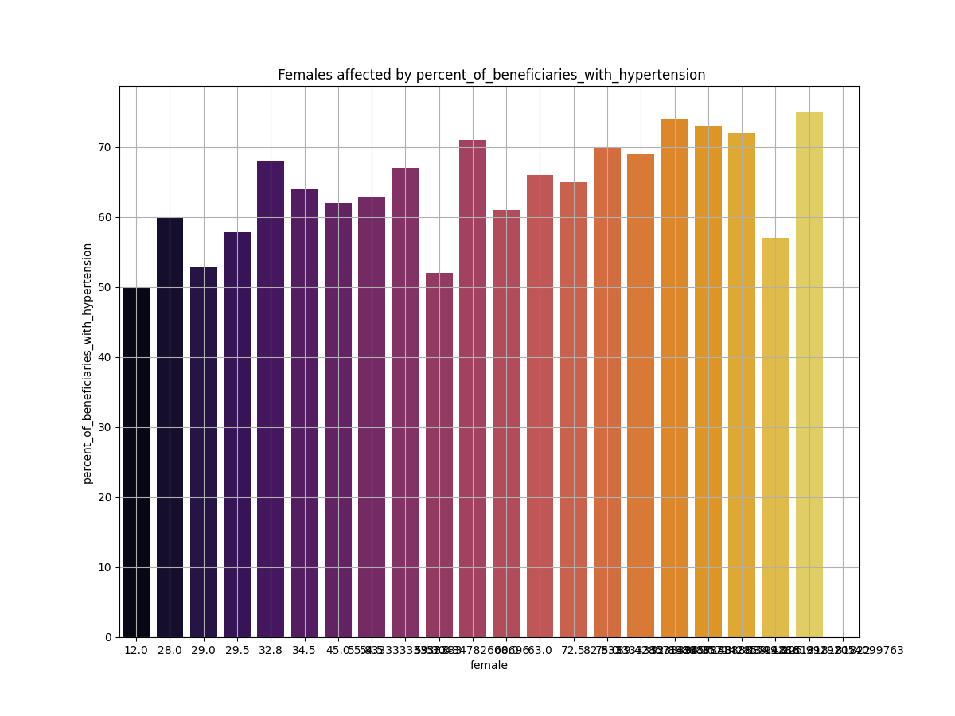
Graph 2:
Sort by gender – Graficele acestea masive reprezinta o analiza a femeilor si barbatilor cu anumite boli. Fiecare bara reprezinta un oras diferit – pentru a putea avea cat mai multe procentaje si o statistica cat mai accurate.

Slide 15
Scripts 3:
Main3.py - provide_type: -This script is part of the cms_codes dataset and not cms_medicare (considering that medicare is extended over 4 datasets), which has a target to check how long the treatment descriptions are - very often doctors use few words to describe a problem. The idea is to be able to check if a detailed description is needed in the reports, or if a concise message reaches the majority.

Slide 16
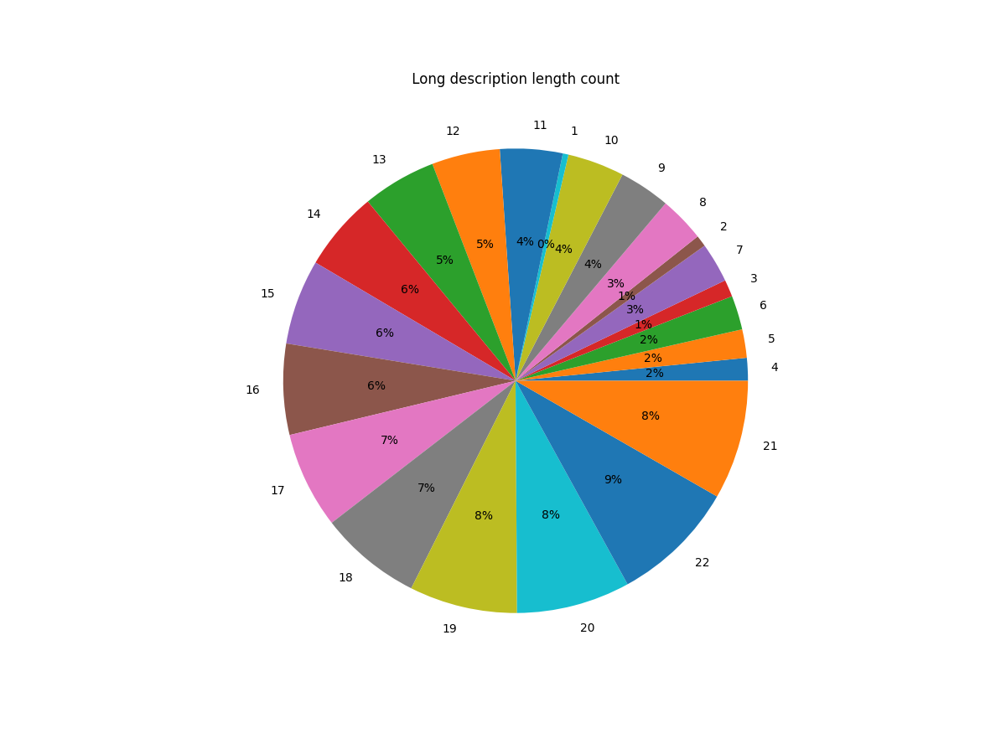
Graph 3:
Sort by count – Sorted according to the number of words (outside the chart) and then the percentages of how often a doctor would describe a case briefly with less than 3-4 words.

Slide 17
Scripts 4:
Main4.py - desc_length: - This goes into another dataset - medicare has 5 datasets being extremely vast. What is interesting about this dataset is how doctors describe health problems using a combination of short description and long description. This allows me to realize the frequency of a problem.

Slide 18
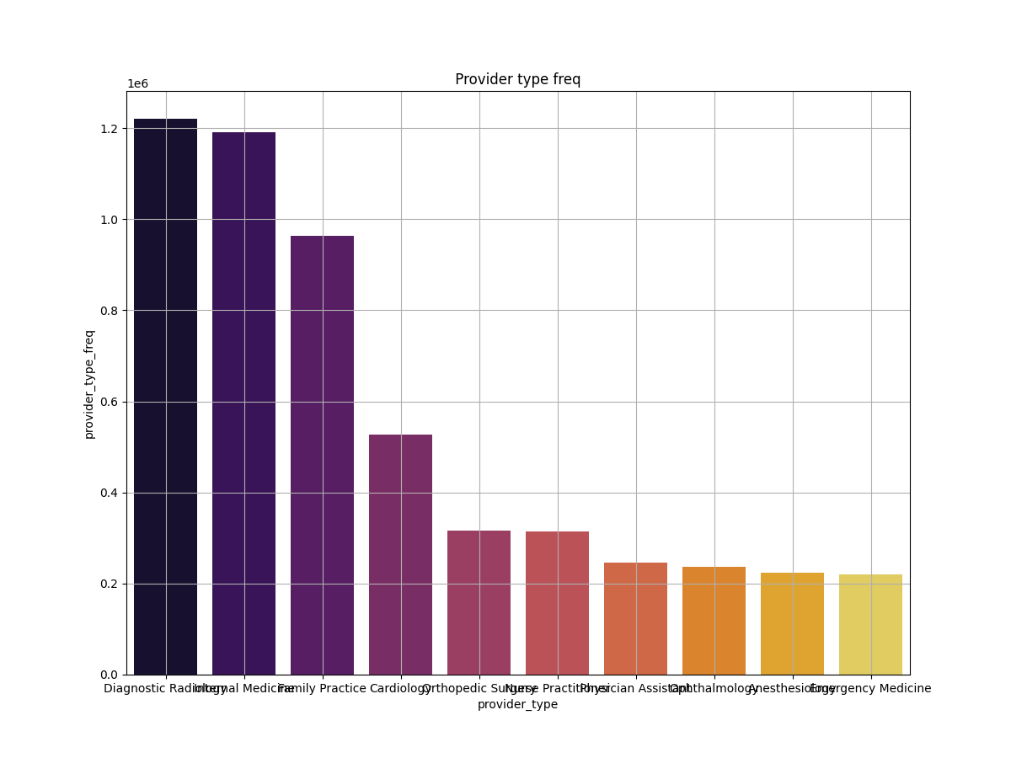
Graph 4:
Sort by diagnostic - Practically here we see that most often people use medication for diagnosis / radiology and internal medicine. Radiology always needs interpretation so automatically generated reports are difficult.

Slide 19
Technical Details
gsutil cp main4.py gs://bda_bucket_2022
# I created a cluster - and I have to use the pyspark jar to run it - and then in the targeted bucket it will execute the query
gcloud dataproc jobs submit pyspark main4.py --region=us-central1 --cluster=cluster-f937 --jars=gs://spark-lib/bigquery/spark-bigquery-latest_2.12.jar
# I used bigquery helper so that I could execute all the queries that were requested - and the targeted project must be written directly.
Most resources are from here:
https://cloud.google.com/dataproc/docs/tutorials/bigquery-connector-spark-example#pyspark

Slide 20
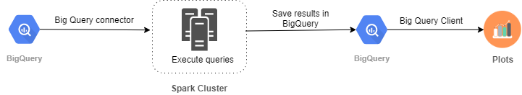
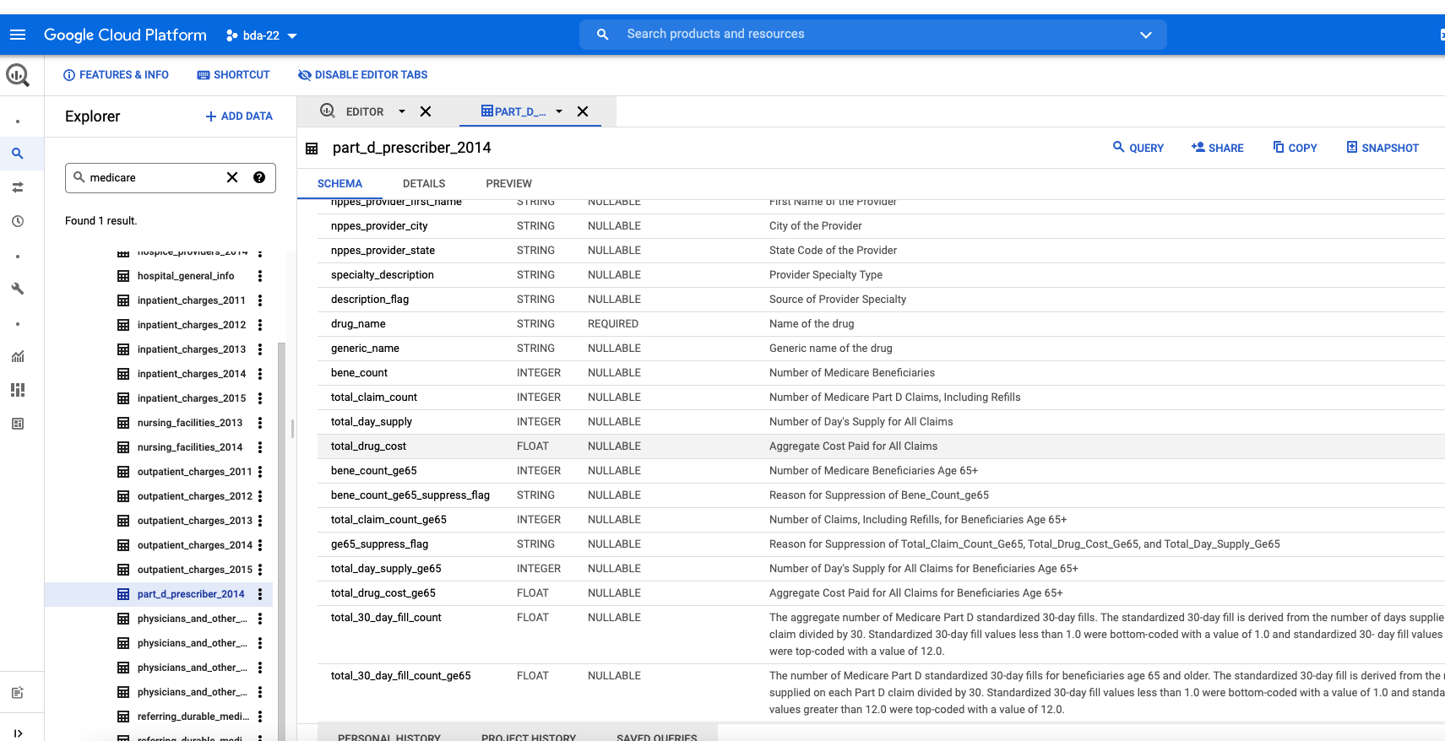
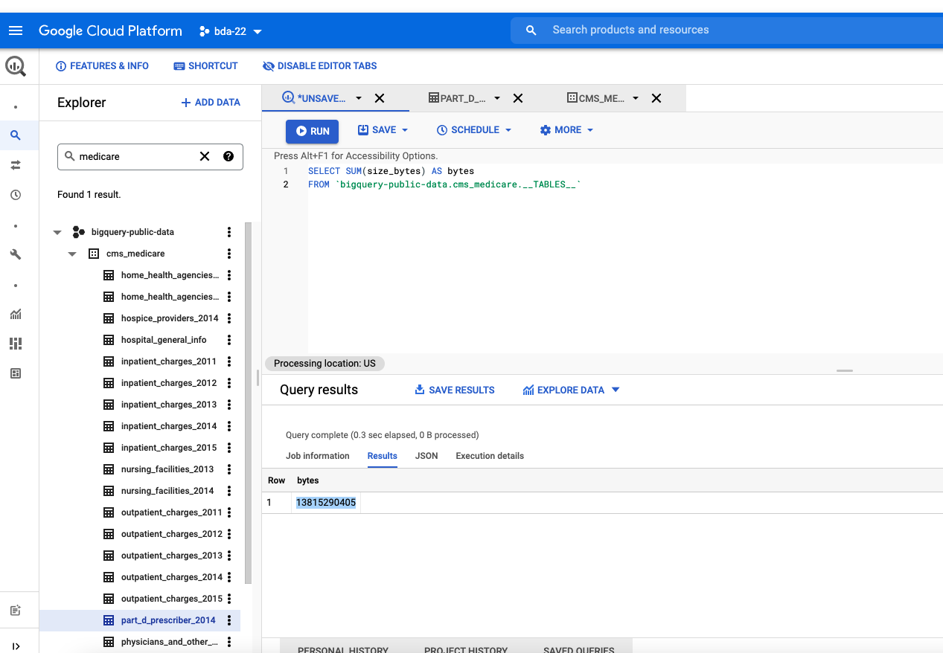
Technical Details

Slide 21
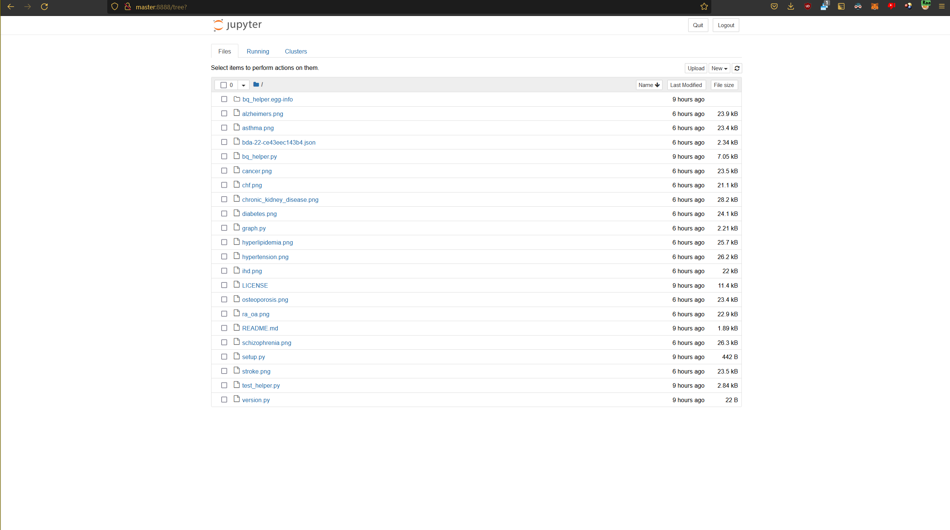
Technical Details - RAAS

Slide 22
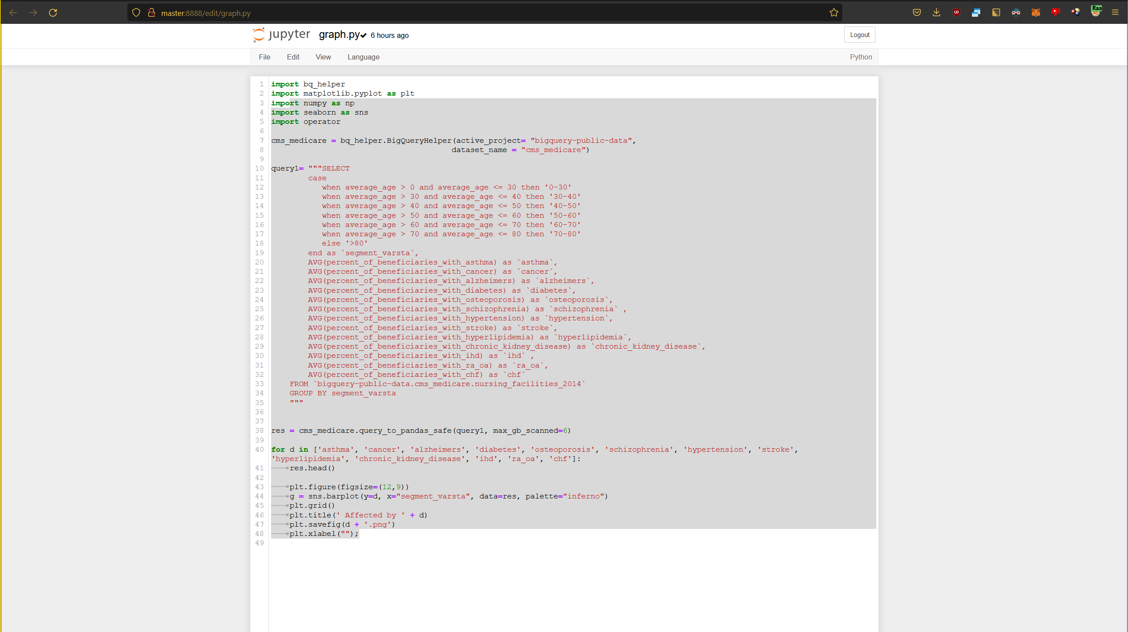
Technical Details - RAAS

Slide 23
K-Means - Exemplu
Din datasetul de la medicare am exportat ca CSV tabelul cu nursing_facilities_2014
Pe tabelul acesta am rulat un K-means pe coloanele average_length_of_stays_days si distinct_beneficiaries_per_provider, unde un entry in tabel este un spital. Si practic rulam un k-means care clusterizeaza un spital in functie de aceste 2 metrici: distinct_beneficiaries_per_provider si average_length_of_stays_days, in unul din cele 4 clustere formate. Astfel putem vedea 2 diagrame
Prima reprezentand un plot cu centroizi formati dupa ce am rulat k-means pe subsetul nursing_facilities_2014 din dataset de la Medicare
Iar al doilea este o diagrama cu toate clustere reunite si sunt plotate cu una din culorile: rosu, galben, verde si negru in functie de clusterul caruia ii apartine), astfel pe aceasta diagrama am plotat si centroizii.

Slide 24
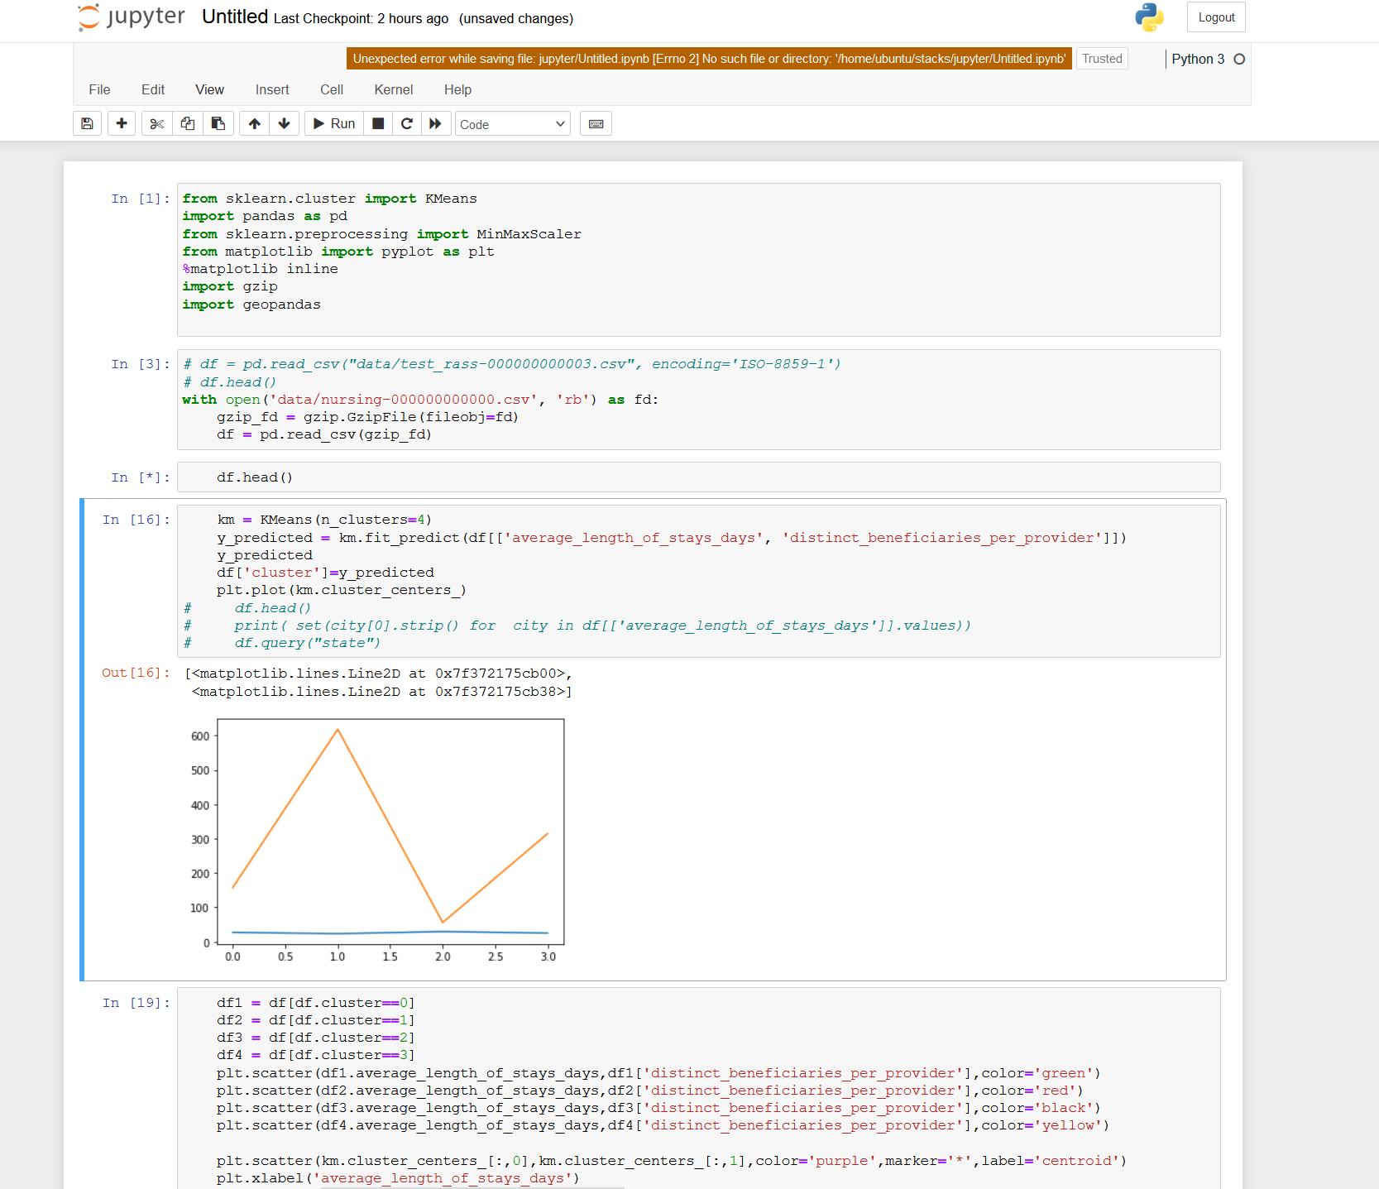
K-Means – Example – check html file for more

Slide 25
Reversie Lineara – Exemplu
Am facut cate un query pe datasetul de la Medicare pentru fiecare din tabelele inpatient_charges pentru fiecare din anii (2011, 2012, 2013, 2014, 2015).
Am plotat un geo map pentru primele 2 query-uri pentru a avea un visual al tuturor datelor.
Dupa am colectat si gruptate toatee datele rezultate in urma celor 5 query-uri in o structura de forma {stat: {an: valoare}}.
Unde Stat ia valori pentru toate statele americane, iar An ia valori in intervalul (2011, 2012, 2013, 2014, 2015), deci pentru toti cei 5 ani folositi si in query-uri.
Pe baza structurii noi obtinute, am antrenat un model de regresie liniara care sa prezica valoarea pentru un stat in anul 2016.
Pe baza valorilor prezise de regresia liniara am facut un nou geo map cu datele prezise pentru anul 2016.

Slide 26
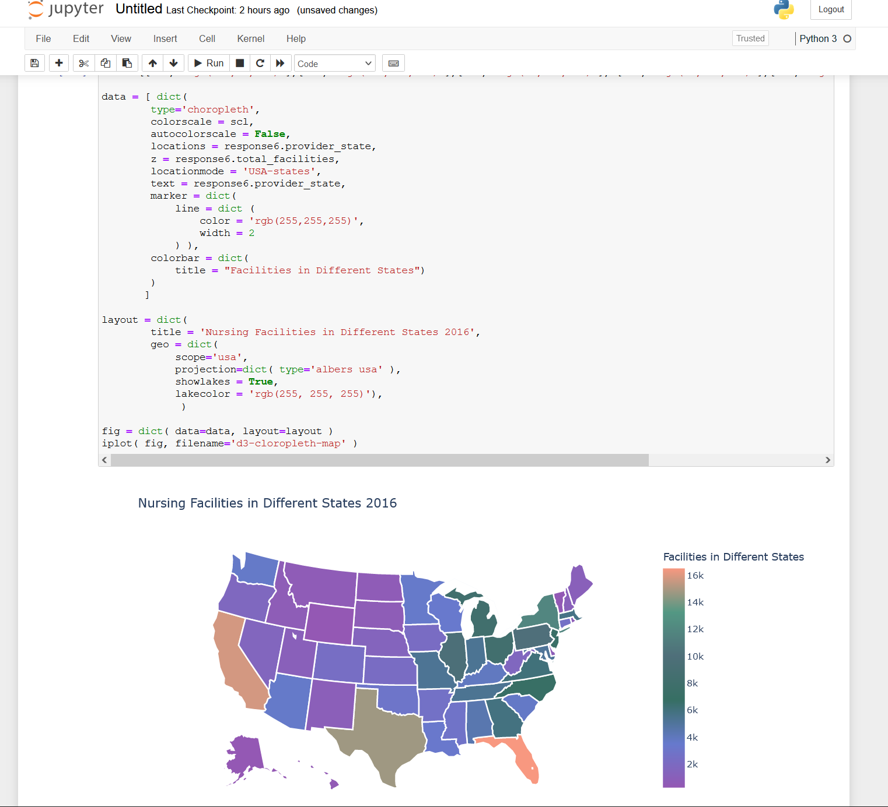
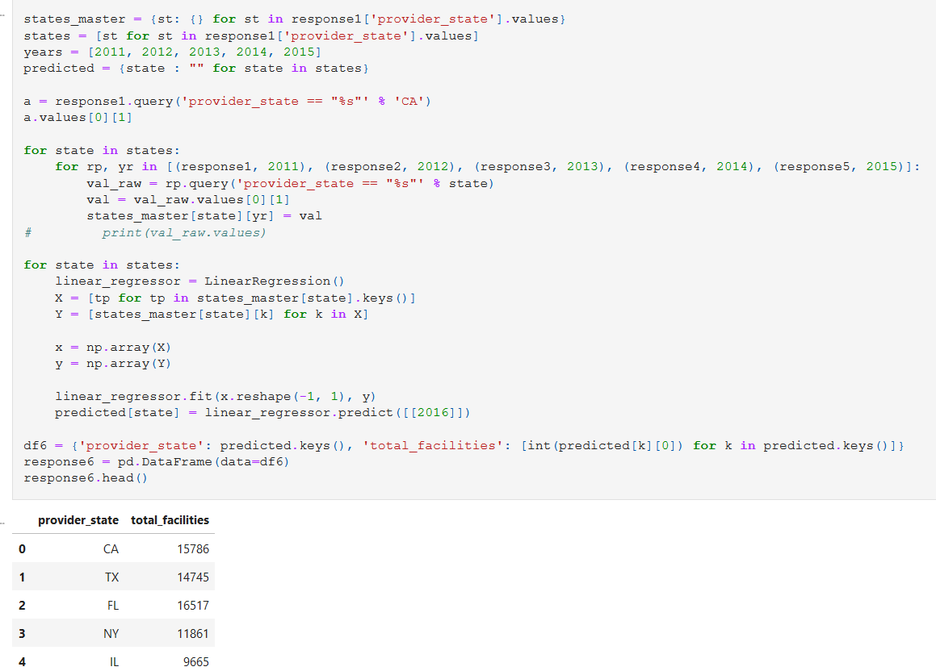
Linear Reversion– Example – check html file for more

Slide 27
Other research using Medicare
https://journalofbigdata.springeropen.com/articles/10.1186/s40537-019-0225-0#Sec7 –
Medicare fraud detection using neural networks – in 2019 was published and uses Medicare datasets.
https://towardsdatascience.com/analyzing-medicare-data-in-python-9417eaa140a6
Analysis of medicine sold in Medicare.

Slide 28
Thanks!
ANY QUESTIONS?
You can find me at silvan.niculita@protonmail.com

